Slide 1
Notes:
Hello everyone and welcome. My name is Greg and I am very cognizant of the fact that I am the only thing standing between you and the bar, or your trip home, so I hope we can have a little fun in this last session of the afternoon.

Slide 2
Hitting the LNKs with DPRK
Proofpoint
Greg Lesnewich
Sr. Threat Researcher
Notes:
I work with in Proofpoint's threat research organization & am primarily tasked with Detecting, tracking, and disrupting North Korean cyber threats targeting Proofpoint customers.
And our topic for this session is hitting the Links with DPRK, where we will examine the overall adoption of LNK files in the threat landscape, how 3 distinct North Korean clusters use them quite differently, and why tracking LNK file usage can be so fruitful.

Slide 3
DISCLAIMER
The content of the presentation(s) is strictly confidential.
All rights to the material featured in the presentation(s) are owned for use by, Proofpoint, Inc. and are protected by copyright laws, international treaty provisions and other applicable laws. You may not copy, reproduce, republish, download, screen capture, post, broadcast, transmit, make available to others, or otherwise use the content or presentation in any way. You agree not to adapt, alter, or create a derivative work from any of the presentation content. To ensure a fluid discussion environment, we request that the names of event participants including presenters remain confidential.
Any violation of this disclaimer would result in legal proceedings.

Slide 4
SAFE HARBOR
This presentation is provided as a statement of direction regarding our product development activities and is provided for discussion purposes only. It should not be relied upon in making a purchasing decision. The development, release and timing of any features or functionality for our products remains at Proofpoint’s sole discretion.

Slide 5

A Long Time Ago
Notes:
So lets zoom out for a moment. The ecosystem has experienced a shift over the last 18 months or so, driven by Microsoft blocking macros by default. I am blatantly stealing some of this content from my colleagues Selena Larson and Joe Wise’s Crime Finds a Way paper – go read it!
This change has forced everyone along the threat actor food chain to re-examine their methods.
Microsoft announced it would begin to block XL4 and VBA macros by default for Office users in October 2021 and February 2022, respectively.
The changes began rolling out in 2022.

Slide 6
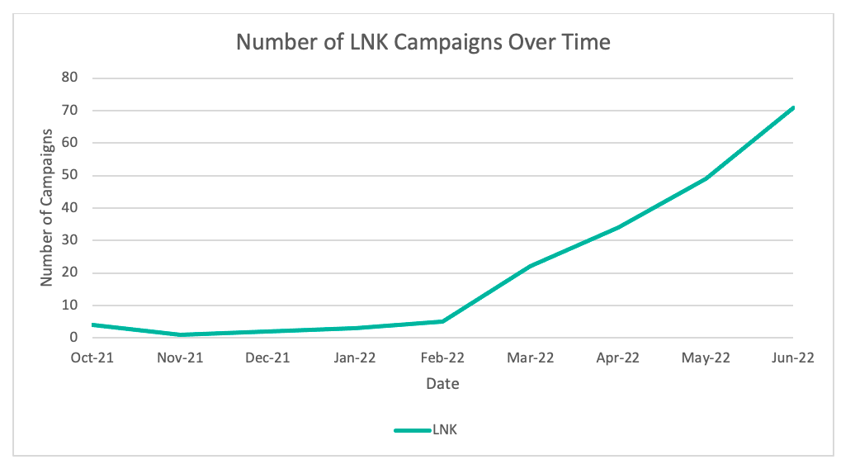
Linking Time
Notes:
And, not so coincidentally, in February 2022. Proofpoint observed a surge in the file format we will examine today - LNKs or link files!

Slide 7
LNK Files
Shortcut (LNK) files were initially favored beginning in mid-2022
LNKs used by at least eight large Initial Access Brokers
North Korea also took note
Notes:
My colleagues on the ecrime team observed at least 8 large ecrime threat actors leverage LNK files in attack chains
Usage of LNKs spiked in June and September 2022.
But it was not just large scale ecrime actors that also reflected this shift – North Korea starting using more LNK files as well

Slide 8
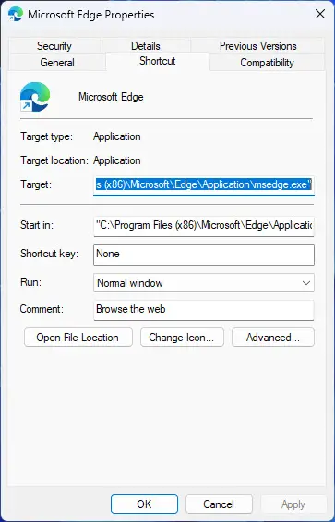
Shortcut Snapshot (LNK Files)
Shell Link Binary File
Main structures:
- Header
- Link Target ID List
- Link Info
- String Data
- Extra Data
Surprising flexibility
Notes:
Files with the extension .lnk are officially known as Shell Link Binary Files
LNK files contain information that points a user’s interaction to another data object on the system. In many instances this is transparent to an end user.
A Windows user may click on the Edge Browser icon in the Start Menu and Edge opens.
What is not shown to the user is that they are executing an LNK file with properties that point to the actual Edge executable.
These files have a lot of flexibility for threat actors, but also are rich in forensic data for us as threat researchers to mine.

Slide 9
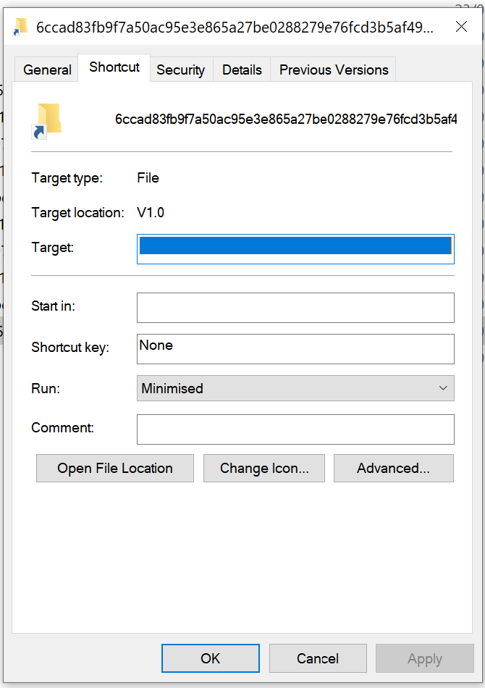
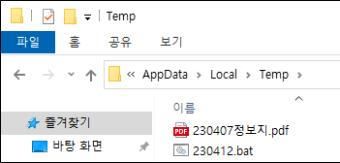
Why Focus on This?
Notes:
LNKs often act as critical components of execution chains in malware delivery.
They may not be the most technically complex portions that `wow` reverse engineers, but they are a crucial part of gaining initial access for the threat actors, because they often act as the social engineering portion of the execution chain.
This is partly due to benign LNKs containing an icon of the application they are launching, so any icon (remote or local) can be used.
Add to that modification of the file name, and suddenly you have a file that may look benign to an average, even trained user.
So for many defenders, understanding LNK executions will happen and monitoring for them can be crucial for defensive efforts

Slide 10
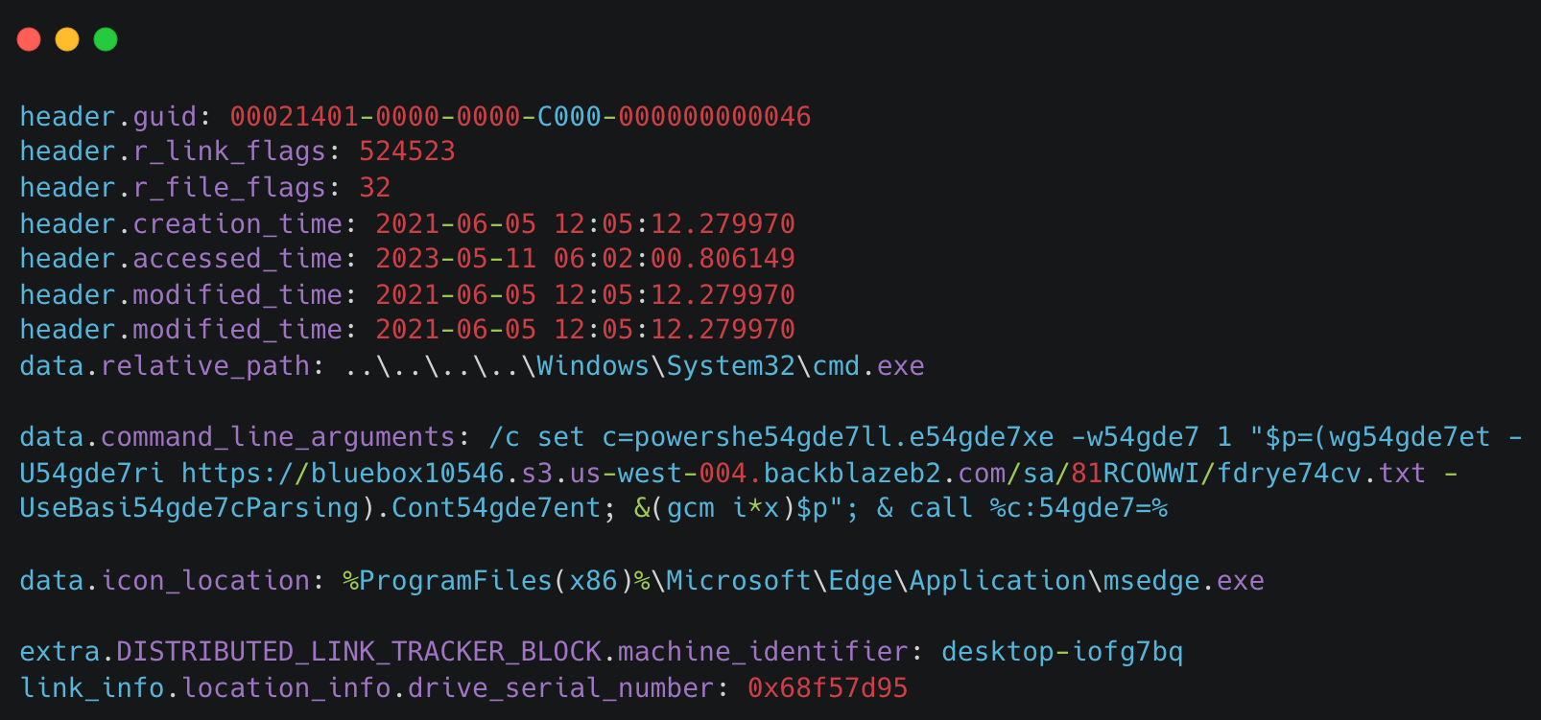
Why Focus on This?
Notes:
From an intelligence perspective, they are also a gold mine for tracking the origin of the shortcut file, including things like the the creation and modification dates, machine name that the LNK was created on, and more about the threat actor machine that built it.
While some threat actors, including North Korea, now spend time scrubbing their components for meta-data and symbols, as they do with Word Documents or executables, some of those patterns can still link malware usage over the years.
Lets dive into how North Korea is using these LNK files!

Slide 11
First Contestant
TA444

Slide 12
TA444
Sapphire Sleet, Bluenoroff, Stardust Chollima, COPERNICIUM
Crypto Kleptos
Tactics
Targets
Tooling
Fake GDrive to ZIP
MacOS + Windows
Fake PDF readers
Backdoored Python & Java
Cryptocurrency Entities
CageyChameleon
RustBucket
JokerSpy
Notes:
TA444 is our first group - unlike the others we'll discuss, their primary tasking is to steal money for the north Korean regime.
They target Crypto-Exchanges, DeFi Orgs, Financial Institutions globally, and their cryptoheists directly contribute to North Korea's nuclear weapons program

Slide 13
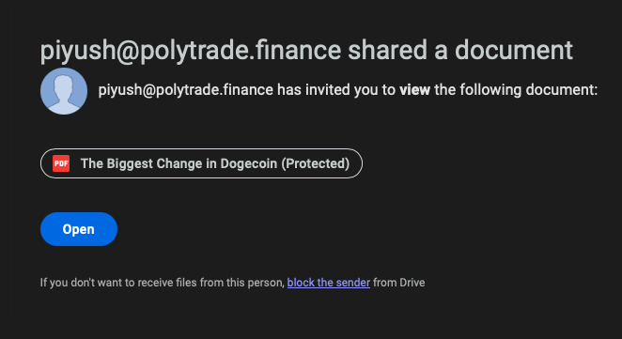
TA444 Lures
Notes:
Lures from TA444 most often spoof Google documents being share from legitimate cryptocurrency entities, and try and entice the user to download a ZIP file containing ...

Slide 14
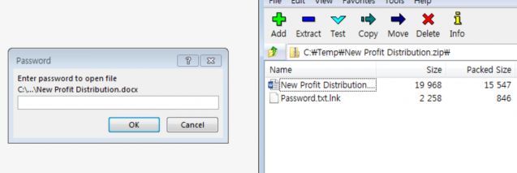
TA444 LNK User Deception
Notes:
a password-protected Document or PDF file, and a bundled LNK so often titled `Password.txt.lnk` they've been using variations of these bundles since 2018! Their use is simple - execution of the next stage payload!

Slide 15
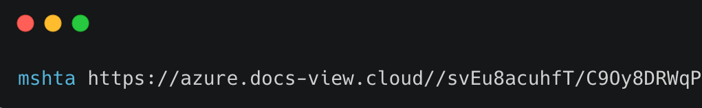
Getting Started
Notes:
and when they started, it was simple! using MSHTA to execute whatever is waiting at that URL which is usually a VBScript or JavaScript payload called

Slide 16
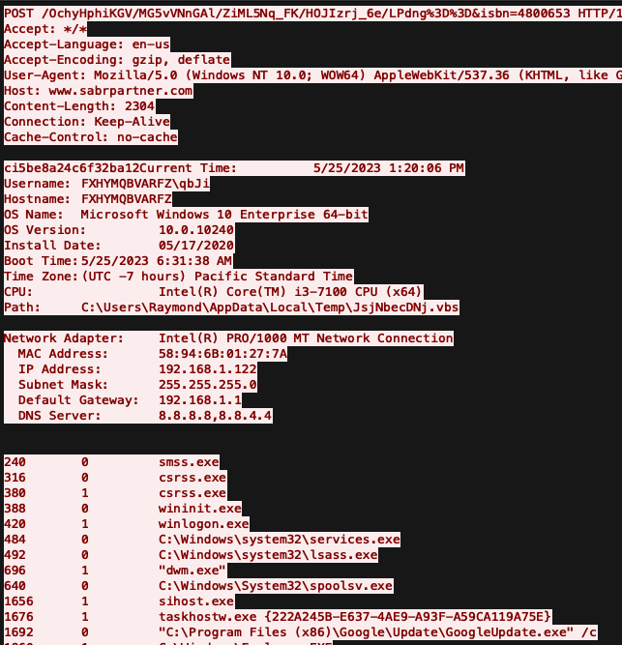
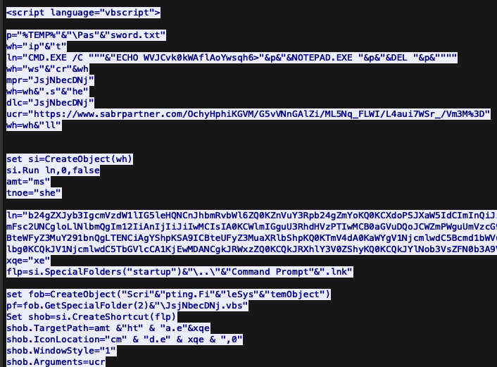
CageyChameleon
Notes:
CageyChameleon (aka CabbageRAT) , a victim-profiling framework, which will exfil running processes and host information while setting up the potential to launch subsequent tooling loaded from the command-and-control server.

Slide 17
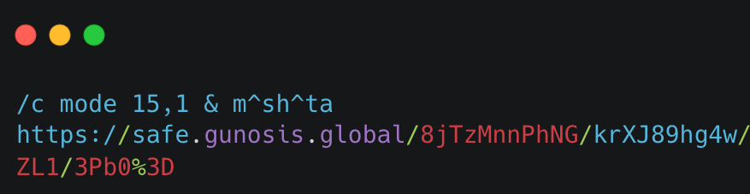
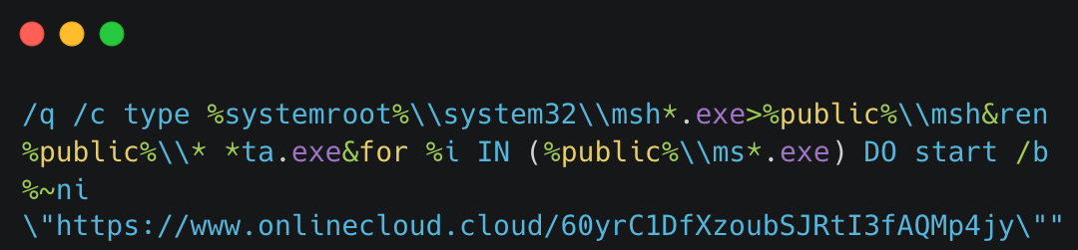
A Little Obfuscation
Notes:
through out the years, they have progressed their obfuscation methods, trying a myriad of ways to execute a payload via MSHTA, without actually including the MSHTA name inside of the LNK to avoid easy detection. The carets in the first example do an okay job, and the splitting of MSHTA via wildcards might be a little better?

Slide 18
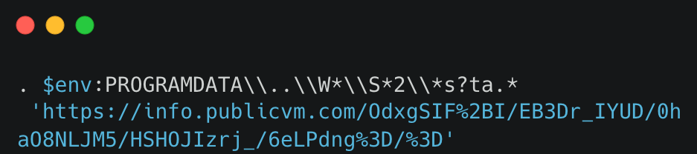
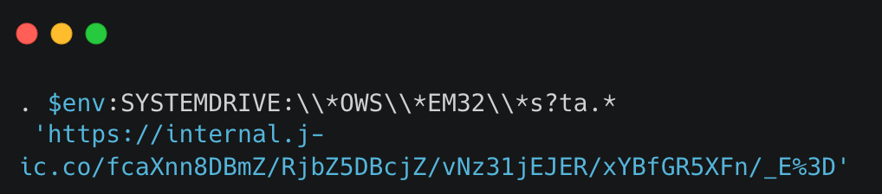
Back to Basics
Notes:
But more recently they've gotten a bit more cheeky with the hiding of the MSHTA name with different wild carding methods for both the binary and the path to try and obfuscate their execution.
Thats tricky, but if you find a guy called Jeremy Hedges after, maybe with enough top shelf drinks he'll tell you their weakness here :)

Slide 19
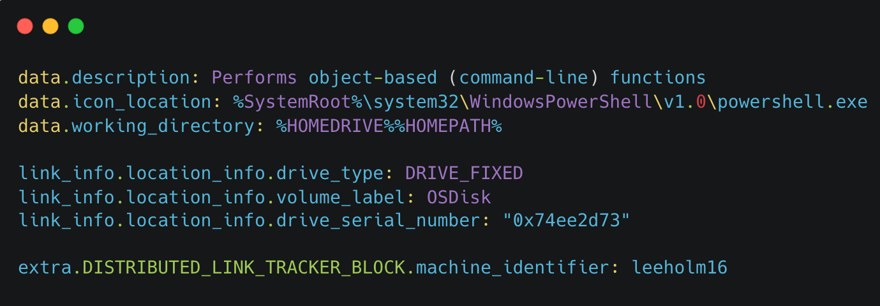
Metadata Leftovers
Notes:
And of course, since we have raged on and on about how valuable the LNK meta data properties are – TA444 is consistently reusing the same spoofed machine name (Lee Holm, a legitimate developer of powershell) on what is very likely the same host

Slide 20
Second Contestant
TA427
Notes:
moving right along, the next group we'll cover is TA427! [CLICK]

Slide 21
TA427
Emerald Sleet, THALLIUM, Kimsuky
Benign Conversationalists
Tactics
Targets
Tooling
Direct Intelligence Collection
Fake Zoom Installers
ISO or Word Doc Lures
Think Tanks
Higher Education
Government
RandomQuery
BabyShark
ReconShark
Notes:
You might call them an arm of the "Kimsuky" cluster - TA427 will send benign messages for weeks to months if the targets reply to the initial message, because why use a keylogger when you can directly ask the target the intelligence questions you are tasked with finding out?
TA427 likely gathers strategic intelligence on behalf of the North Korean regime, and has begun directly asking foreign policy experts about their opinions, either in email or document form.
The threat actor will also use such conversation starting efforts to infect targets with malware such as RandomQuery or BabyShark.

Slide 22
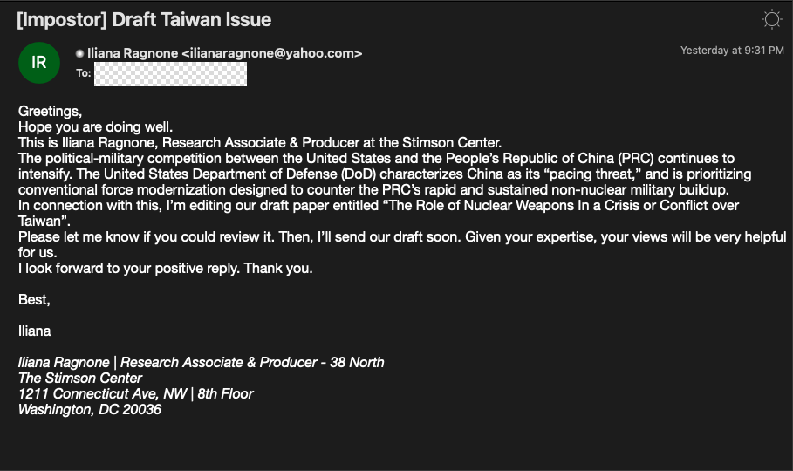
TA427 Lures
Notes:
Here is an example of their lures asking about nuclear weapons in relation to regional conflicts, requesting the target agree to review the draft of a fake paper

Slide 23
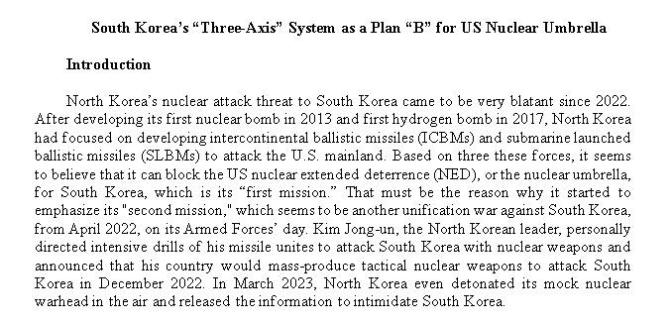
TA427 Lures
Notes:
if one engages with them long enough, the actor will eventually send a password protected document. The macro and surrounding tooling is tracked as ReconShark, initially named by SentinelOne. You may be confused as to why I'm talking about macros instead of LNKs? Well LNKs come in, in a fun way inside the macro - as a next stage execution & persistence method!

Slide 24
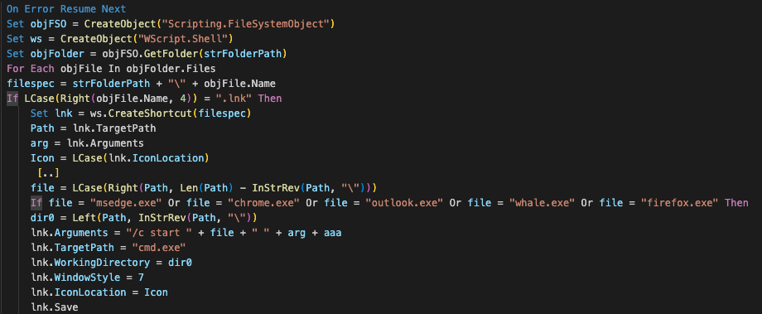
ReconShark - LNK as Persistence
Notes:
ReconShark deploys and executes payloads in different ways. one of those ways is ReconShark edits Windows Shortcuts (LNK files) common web browsers or mail clients

Slide 25
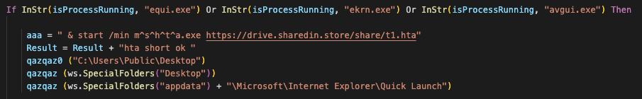
ReconShark - LNK as Persistence
Notes:
The shortcut files are effectively legitimate, but tampered shortcuts, present on the victim's desktop. When executed, these LNK files start the linked legitimate applications and execute malicious code at the same time.

Slide 26
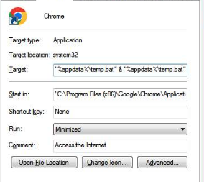
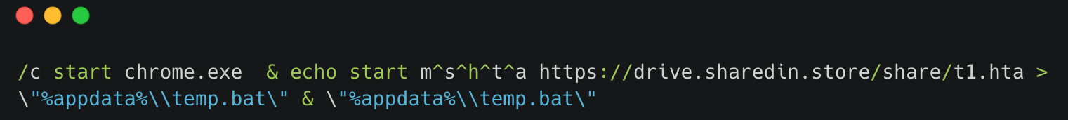
ReconShark - LNK as Persistence
Notes:
apologies for the terrible resolution here, but that is a TA427 dropped LNK that executes the chrome binary, and also downloads a remote HTA & executes it as a batch file. So again, pretty good for fooling the user, and actually cleans up a lot of the leftover metadata issues.

Slide 27
Third Contestant
TA409
Notes:
and our last group of the day is TA409.

Slide 28
TA409
RedEyes, Scarcruft, APT37, InkySquid, Ricochet Chollima, Pearl Sleet
Tactics
Targets
Tooling
Watering Holes
LNK-based Phishing
Browser Exploits
CHM / HTML Cred Harvest
Dissidents
North Korean Defectors
Human Rights NGOs
ROKRAT
GOLD BACKDOOR
Chinotto
Notes:
You all might know them as Scarcruft, Reaper, or APT37.
They are likely the most talented group operating in North Korea, partly because of the grudge match they are engaged with - They are heavily interested in targeting North Korean defectors and human rights organizations in South Korea, and their lures [CLICK]

Slide 29
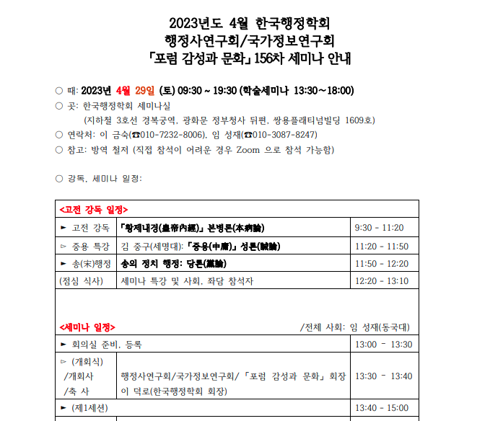
TA409 Lures
Notes:
reflect that. The lure here is actually dropped by, not alongside, TA409's LNK tooling.
The document is spoofing a seminar for the Korean Association for Public Administration, and includes a Zoom link and itinerary
But their LNK usage is expansive
and [CLICK]

Slide 30
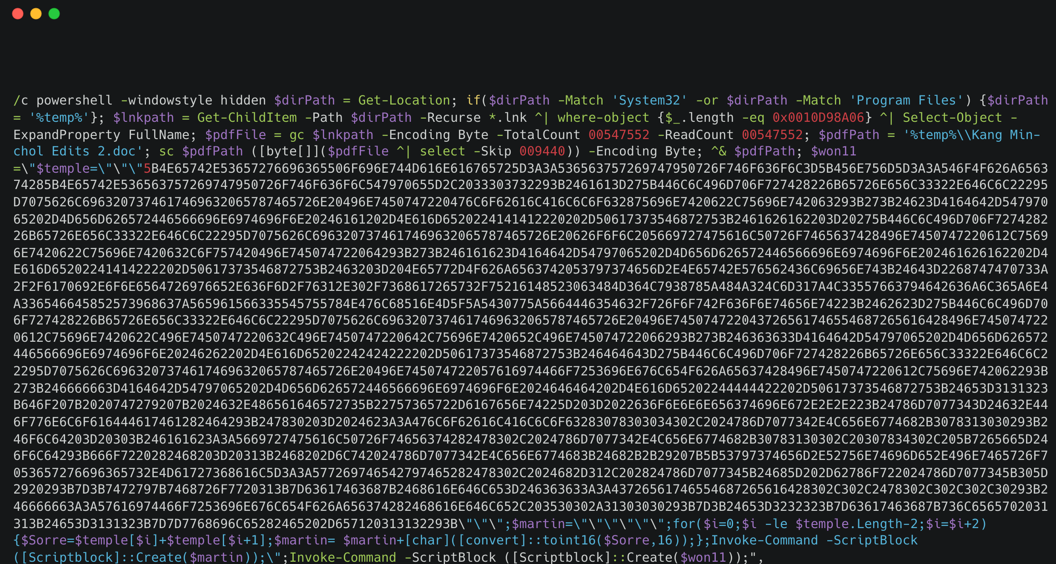
Fully Featured Loader
Notes:
they play a fun game called how much functionality can we stuff into an LNK file? the first blank chunk there is padding to hide the embedded command from the user, seeing that many sequential spaces sets of alarm bells for us
the LNK kicks off an powershell execution chain that reads the contents of the LNK file itself, finds an appended Word Doc file to open & display to the user, before decoding a next stage command

Slide 31
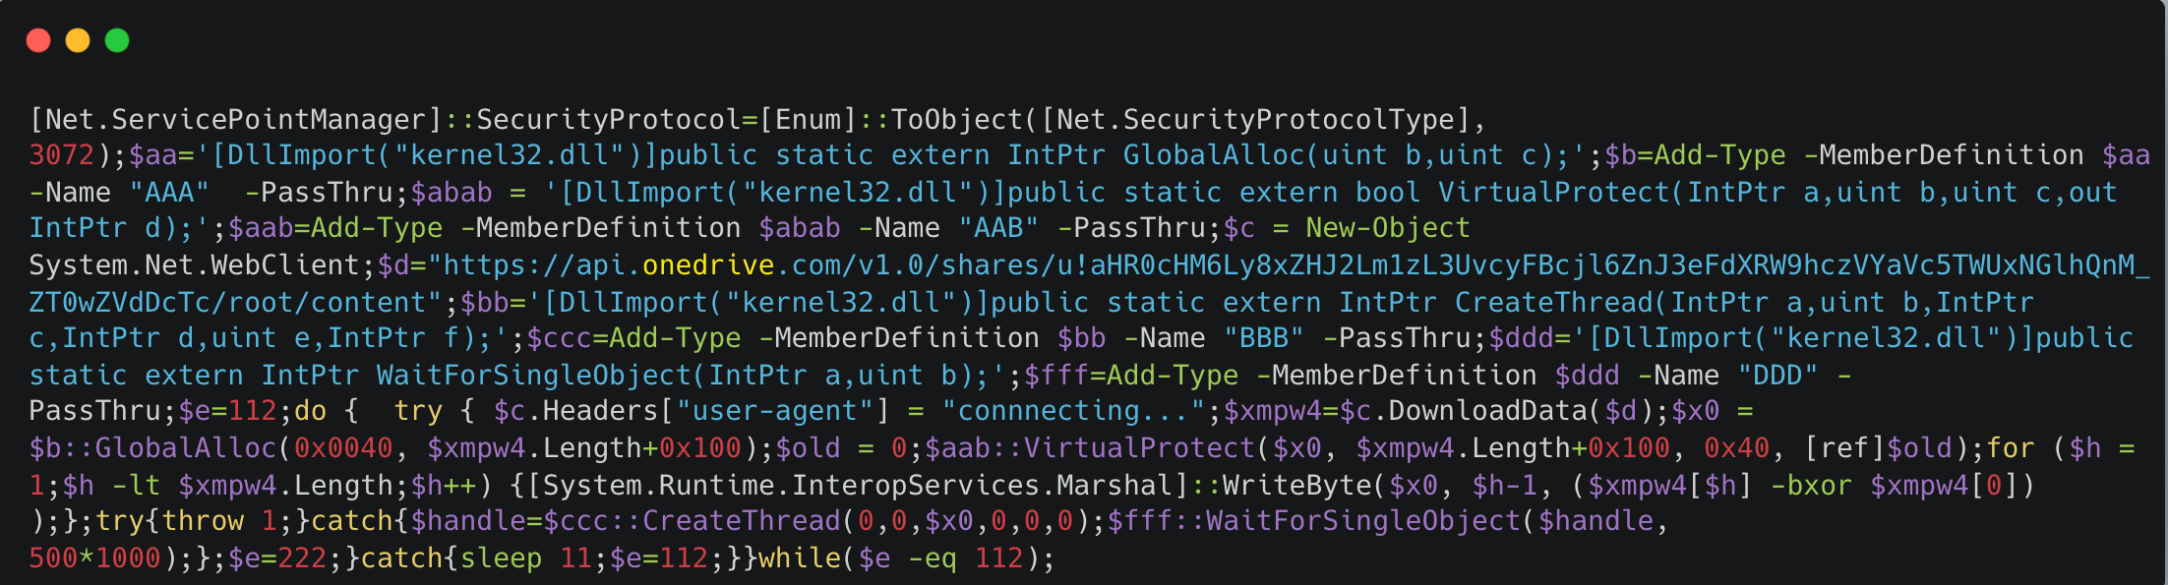
Fully Featured Loader
Notes:
if we decode that main hex blob, we get some additional powershell
If we clean that up

Slide 32
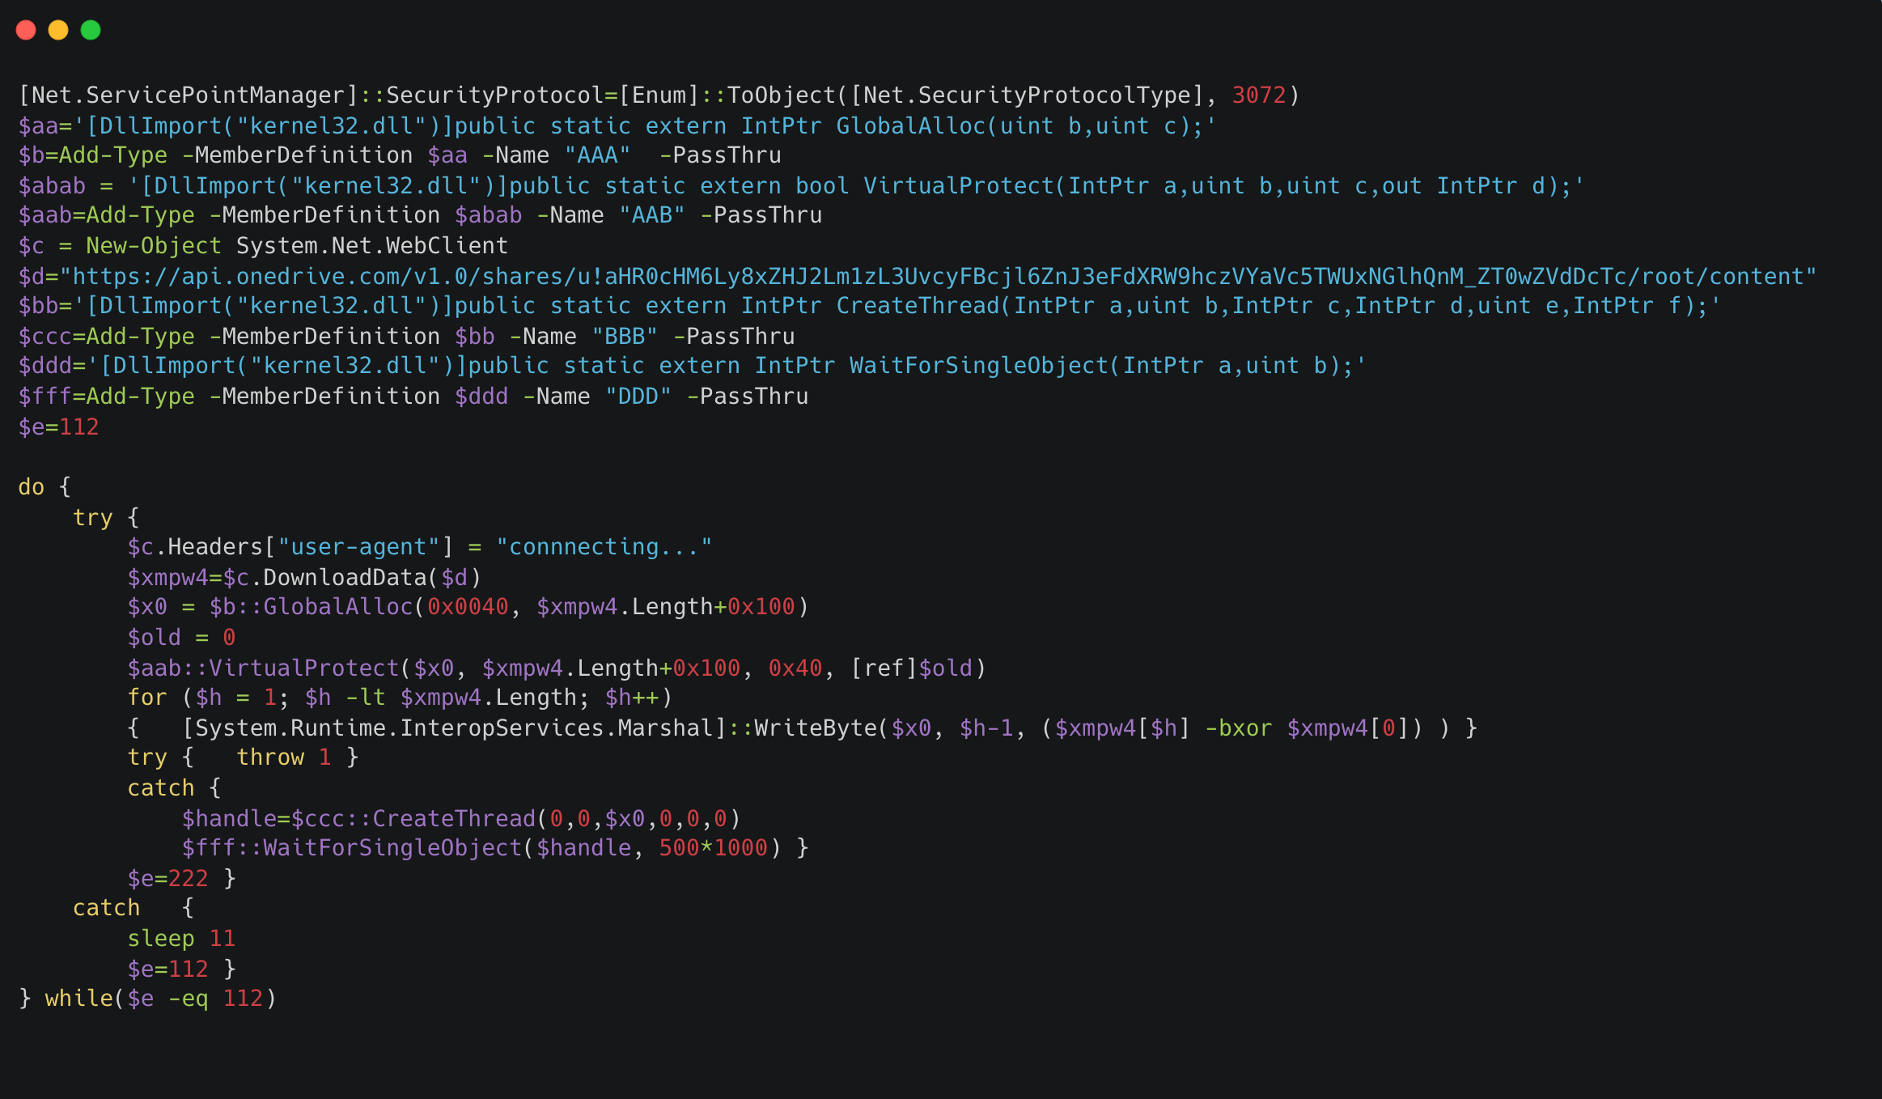
Fully Featured Loader
Notes:
we are left with some well written Powershell to download, decrypt, and execute a payload into memory.

Slide 33
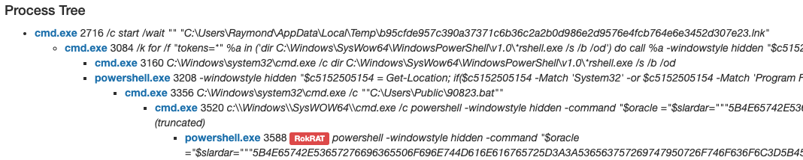
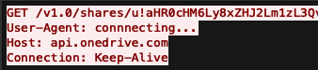
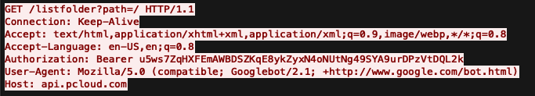
Fully Featured (and Noisy) Loader
Notes:
That downloaded file is usually a shellcode loader for Gold Backdoor or ROKRAT.
This actor will use onedrive as we see here, or alternatively pCloud or Yandex for remote hosting and C2

Slide 34

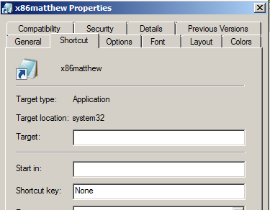
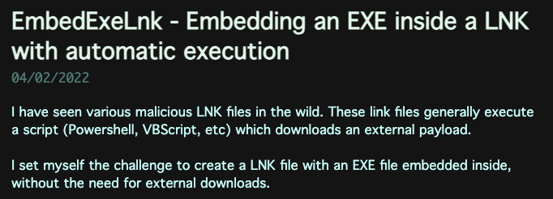
Source Code?
Notes:
despite all of these tricks, we think we know where this builder suite was sourced from.
An alias called x86matthew published code to embed an EXE inside an LNK + execute it with powershell, using very similar code & padding styles to what we see from TA409

Slide 35
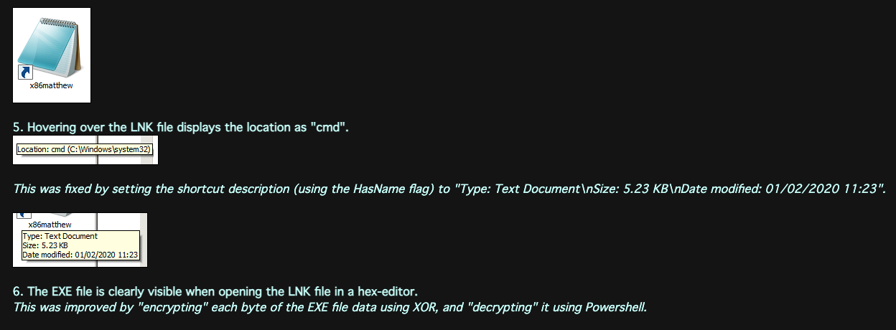
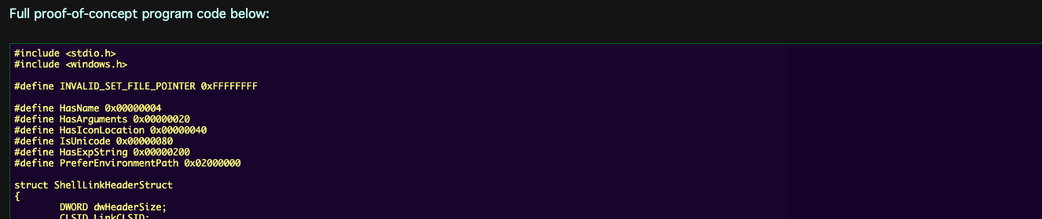
Source Code?
Notes:
The effort in the source code is extensive, to ensure the LNK lure's properties and information seen from hovering show something benign to the user.
While we've seen other actors use this builder, so far only TA409 has added showing an embedded lure document and cloud download and execution, which leave some distinct tool marks for us to track

Slide 36
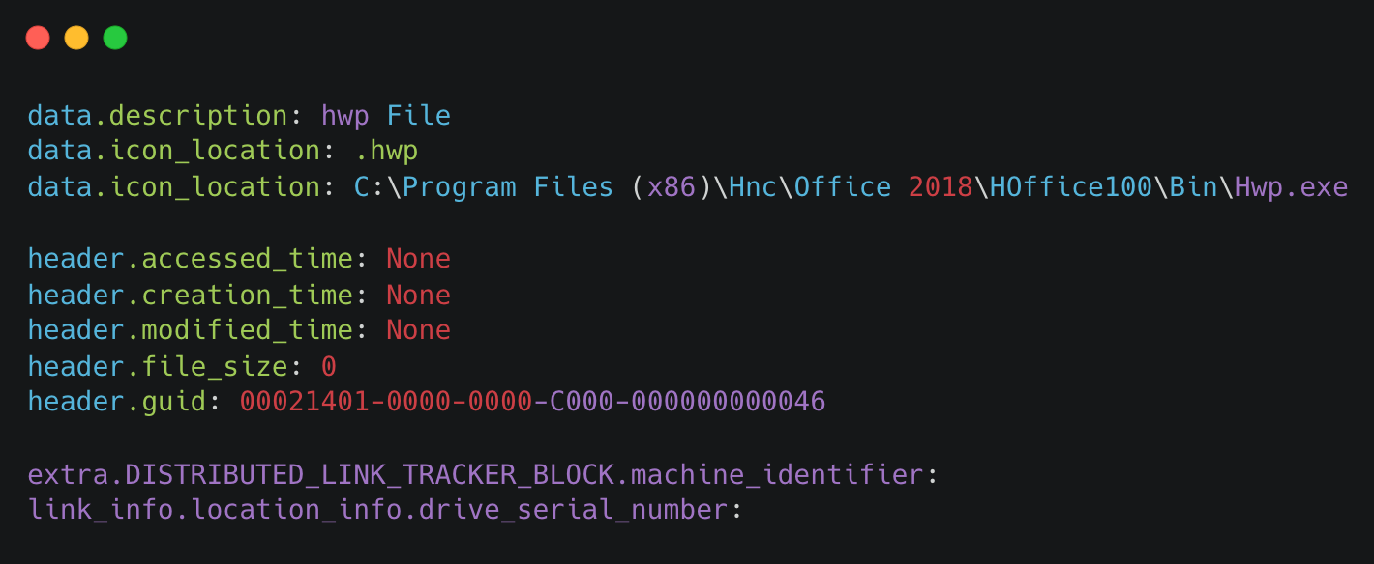
Delicious Leftovers

Slide 37
Wrapping Up
Notes:
and with that, we have reached the end. While I could find something clever to say about LNKs, I wanted to thank you all for sticking around & for attending Protect this year. We here at Proofpoint hope you've found it valuable, informative, and fun!
Thank you all so much for your time, get home safely, and we'll see you here next year!

